Slide 1

Project 1
Fitzpatrick and Shubham

Slide 2
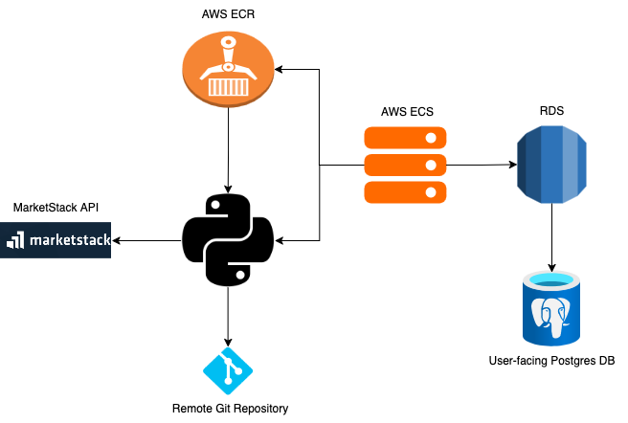
System Architecture Diagram

Slide 3
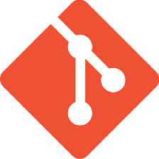
Version Control
Pushed code changes to branches via Git to a GitHub repository
Utilized branching strategy for various aspects of the project (ETL, Docker, AWS resources, etc.)
Merged code via Pull Requests

Slide 4
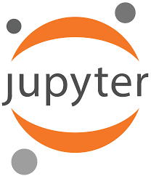
Iteration 1: Jupyter Notebook
Used secrets_config.py for credentials
Developed interactive and user-friendly notebook to interact with the MarketStack API and pull data into Pandas dataframes
SQL Alchemy Python API for pushing data into Postgres

Slide 5
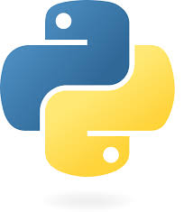
Iteration 2: Python Scripting
Separation of concerns: breaking up different aspects of the code into functions
Used a .env file for reading environment variables

Slide 6
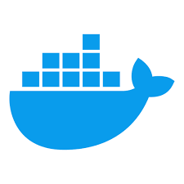
Iteration 3: Docker
Containerized the Python application from Iteration 2
Modularized code by component (database, testing, ETL operations, pipeline)

Slide 7
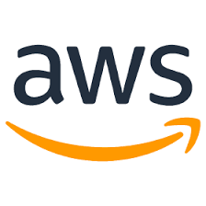
Iteration 4: AWS
Created an RDS instance for the application to write to a Postgres DB
Packaged up the application using ECR, AWS’s managed version of Docker
Deployed the application using ECS tasks
Environment variables managed in AWS

